Slide 1







Course Title: Financial Accounting Course Code: ACT 101 Course Instructor: Fairose Farin Chapter3:Adjusting the Accounts

Slide 2

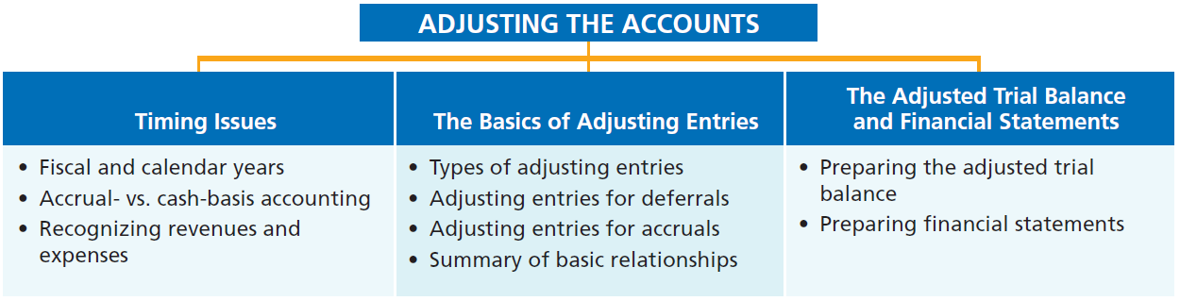

PREVIEW OF CHAPTER 3
Financial Accounting
IFRS 3rd Edition
Weygandt ● Kimmel ● Kieso

Slide 3
CHAPTER
3
Adjusting the Accounts
LEARNING OBJECTIVES
After studying this chapter, you should be able to:
Explain the time period assumption.
Explain the accrual basis of accounting.
Explain the reasons for adjusting entries.
Identify the major types of adjusting entries.
Prepare adjusting entries for deferrals.
Prepare adjusting entries for accruals.
Describe the nature and purpose of an adjusted trial balance.

Slide 4
Timing Issues
Accountants divide the economic life of a business into artificial time periods (Time Period Assumption).
. . . . .
Jan.
Feb.
Mar.
Apr.
Dec.
Generally, a month, a quarter, or a year.
Time Period Assumption also known as the “Periodicity Assumption”

Slide 5
EXAMPLE
Coca-Cola has been in business for 138 years, with its origins dating back to May 8, 1886, when Dr. John Pemberton sold the first glass of Coca-Cola in Atlanta, Georgia.
Coca-Cola reports its financial results on a quarterly and annual basis, in line with the time period assumption.
Quarterly Reports (10-Q): Coca-Cola issues reports every 3 months, providing investors and regulators with timely insights into the company’s performance.
Annual Reports (10-K): At the end of each fiscal year, Coca-Cola compiles a full-year report with audited financial statements.
Coca-Cola uses the time period assumption to track sales, revenues, and expenses over each quarter.
Compare performance period over period (e.g., Q1 2025 vs Q1 2024). Identify seasonal trends (e.g., higher beverage sales in summer).

Slide 6
Fiscal and Calendar Years
Monthly and quarterly time periods are called interim periods.
Most large companies must prepare both quarterly and annual financial statements.
Fiscal Year = Accounting time period that is one year in length.A fiscal year usually begins with the first day of a month and ends 12 months later on the last day of a month.such as Vodafone Group’s (GBR) fiscal year which ends March 31.
Calendar Year = January 1 to December 31.

Slide 7
Fiscal and Calendar Years
Question
The time period assumption states that:
companies must wait until the calendar year is completed to prepare financial statements.
companies use the fiscal year to report financial information.
the economic life of a business can be divided into artificial time periods.
companies record information in the time period in which the events occur.

Slide 8
Accrual- versus Cash-Basis Accounting
Accrual-Basis Accounting
Transactions recorded in the periods in which the events occur.
Companies recognize revenues when they perform services (rather than when they receive cash). You record income when it’s earned even if you haven't received the money yet.
Expenses are recognized when incurred (rather than when paid).

Slide 9
Accrual Accounting Example
Imagine you run a small design business:
You finish a $1,000 project on June 30, but your client doesn’t pay you until July 15.
Under accrual accounting, you record the $1,000 as income on June 30 (when the work was done).
Even though the money arrives later, the income is counted when earned.
Similarly, say you get a $300 bill for software you used in June, but you’ll pay it in July.
You record the $300 expense in June, not July, because that’s when you used the service.

Slide 10
Accrual- versus Cash-Basis Accounting
Cash-Basis Accounting
Revenues are recorded when cash is received.
Expenses are recorded when cash is paid.
Cash-basis accounting is not in accordance with International Financial Reporting Standards (IFRS).
LO 2

Slide 11
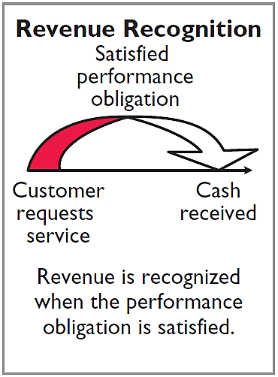
Recognizing Revenues and Expenses
REVENUE RECOGNITION PRINCIPLE
Recognize revenue in the accounting period in which the performance obligation is satisfied. A business should recognize revenue only when it has done what it promised to do for the customer.
Example: On August 1, a client hires you to build a website for $5,000.You finish and deliver the website on August 20.The client pays you on September 5.
You record the $5,000 revenue on August 20 — the day you completed the service and earned the income.
It doesn’t matter that you were paid in September — revenue is recognized when the work is done, not when the money arrives.

Slide 12
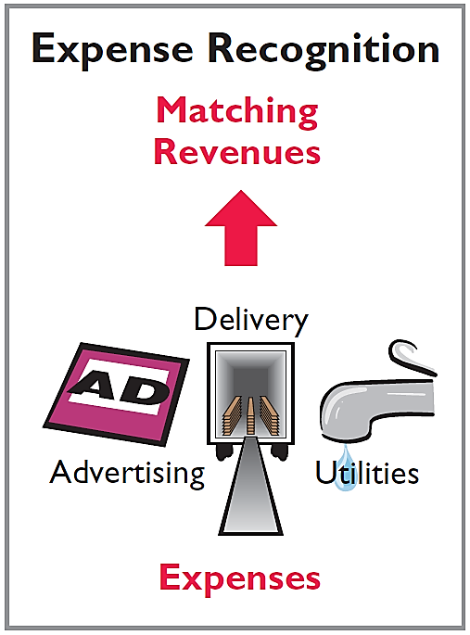
Recognizing Revenues and Expenses
EXPENSE RECOGNITION PRINCIPLE
Match expenses with revenues in the period when the company makes efforts to generate those revenues.
“Let the expenses follow the revenues.” A company should record the costs (expenses) in the same time period as the revenues those costs helped to produce.

Slide 13
Recognizing Revenues and Expenses
EXPENSE RECOGNITION PRINCIPLE( CONT.)
Example: A bakery sells 1,000 cakes in June and earns $50,000.To make those cakes, the bakery spent $20,000 on flour, eggs, sugar, etc.
Even if the bakery bought the ingredients in May, the $20,000 expense should be recorded in June, because that’s when the cakes were sold and revenue was earned.
This principle helps match expenses with related revenues, giving a more accurate picture of profit for the period.

Slide 14
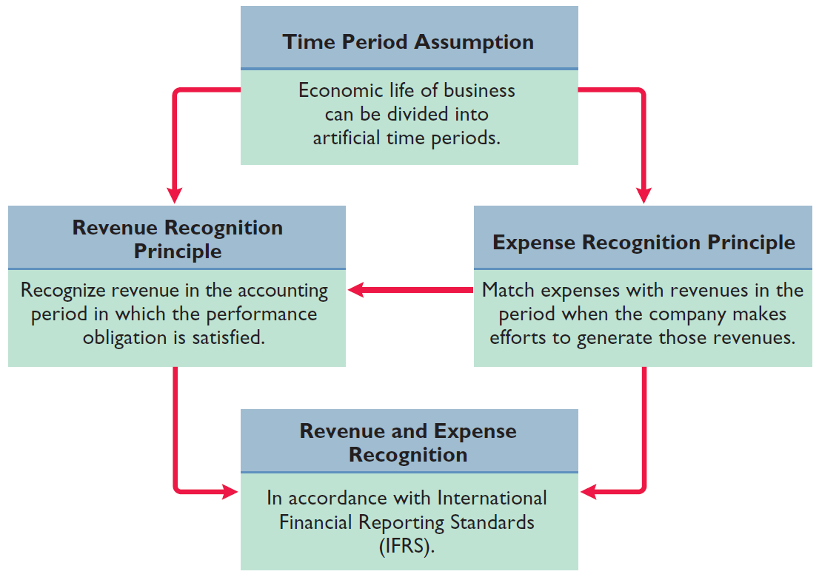
Illustration 3-1
IFRS relationships in revenue and expense recognition
LO 2

Slide 15
Recognizing Revenues and Expenses
Question
The revenue recognition principle states that:
revenue should be recognized in the accounting period in which a performance obligation is satisfied.
expenses should be matched with revenues.
the economic life of a business can be divided into artificial time periods.
the fiscal year should correspond with the calendar year.
LO 2

Slide 16
>
DO IT!
A list of concepts is provided in the left column below, with a description of the concept in the right column below. There are more descriptions provided than concepts. Match the description of the concept to the concept.
1. ___ Accrual-basis accounting.
2. ___ Calendar year.
3. ___ Time period assumption.
4. ___ Expense recognition principle.
f
Monthly and quarterly time periods.
Efforts (expenses) should be matched with results (revenues).
Accountants divide the economic life of a business into artificial time periods.
Companies record revenues when they receive cash and record expenses when they pay out cash.
An accounting time period that starts on January 1 and ends on December 31.
Companies record transactions in the period in which the events occur.
e
c
b
LO 2

Slide 17
The Basics of Adjusting Entries
Adjusting Entries
Ensure that the revenue recognition and expense recognition principles are followed.
They needed because sometimes:
You earned money but haven’t recorded it yet.
You used up something (like supplies or prepaid rent) but haven’t recorded the expense.
You recorded something too early or too late.
Simple example:Imagine you paid $1,200 for a 12-month magazine subscription on January 1.
You paid upfront, but you only use one month’s worth of the subscription in January. At the end of January, you make an adjusting entry to record the expense for just January ($100), not the whole $1,200.

Slide 18
The Basics of Adjusting Entries
Adjusting Entries
Ensure that the revenue recognition and expense recognition principles are followed.
Necessary because the trial balance may not contain up-to-date and complete data.
Required every time a company prepares financial statements.
Will include one income statement account and one statement of financial position account.

Slide 19
Adjusting Entries
Question
Adjusting entries are made to ensure that:
expenses are recognized in the period in which they are incurred.
revenues are recorded in the period in which services are performed.
statement of financial position and income statement accounts have correct balances at the end of an accounting period.
All the responses above are correct.
LO 3

Slide 20
Types of Adjusting Entries
Deferrals
Accruals
1. Prepaid Expenses. Expenses paid in cash before they are used or consumed such as prepaid rent or insurance
1. Accrued Revenues. Revenues for services performed but not yet received in cash or recorded such as accounts receivable
2. Unearned Revenues.
Cash received before services are performed.
2. Accrued Expenses. Expenses incurred but not yet paid in cash or recorded.
LO 4

Slide 21
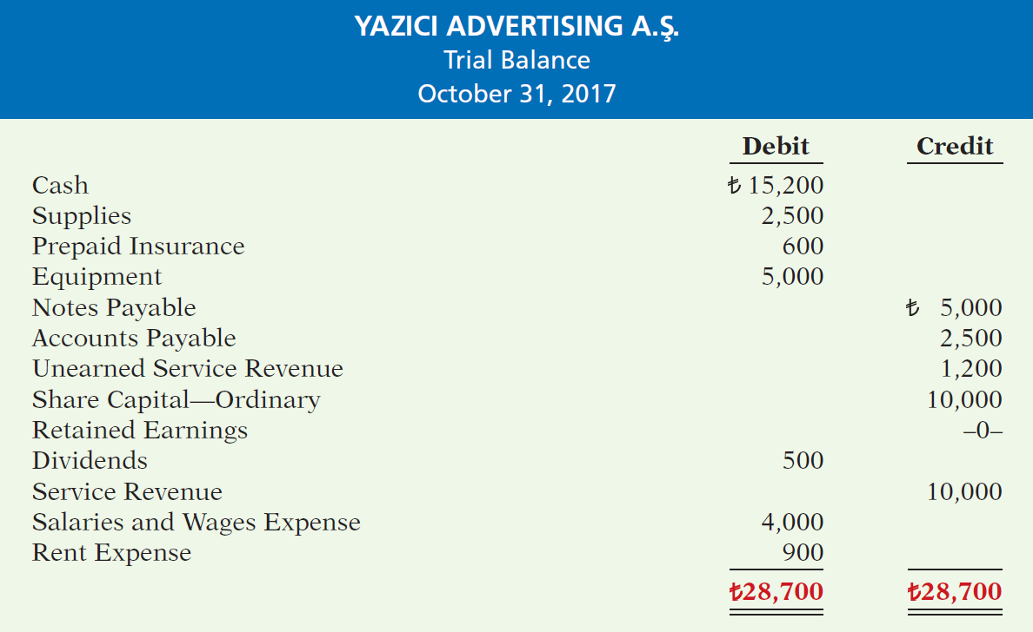
Illustration 3-3
Trial balance
Each account is analyzed to determine whether it is complete and up-to-date for financial statement purposes.
LO 4

Slide 22
Adjusting Entries for Deferrals
Deferrals happen when cash is received or paid before the related revenue or expense is actually earned or used.
Basically, you delay recognizing the revenue or expense until the right time.
Deferrals are expenses or revenues that are recognized at a date later than the point when cash was originally exchanged.
In simple words, deferrals are accounting adjustments made when cash has been exchanged before the related expense or revenue is recognized in the financial statements.
There are two types:
Prepaid expenses and
Unearned revenues.
LO 5

Slide 23
Adjusting Entries for Deferrals
Two main types of deferrals:
Deferred Revenue (Unearned Revenue):
You get paid before you deliver the product or service.
You don’t count it as revenue yet because you still owe the customer.
Later, when you deliver, you recognize the revenue.
Deferred Expense (Prepaid Expense):
You pay before you actually use or consume the service or item. You don’t count it as an expense yet.
Later, as you use it, you recognize the expense.
LO 5

Slide 24
PREPAID EXPENSES
Payments of expenses that will benefit more than one accounting period.
Cash Payment
BEFORE
Expense Recorded
Prepayments often occur in regard to:
insurance
supplies
advertising
rent
buildings and equipment
Example: Paid $1,200 for one year of insurance. Each month, $100 is moved from Prepaid Insurance (asset) to Insurance Expense.
LO 5

Slide 25
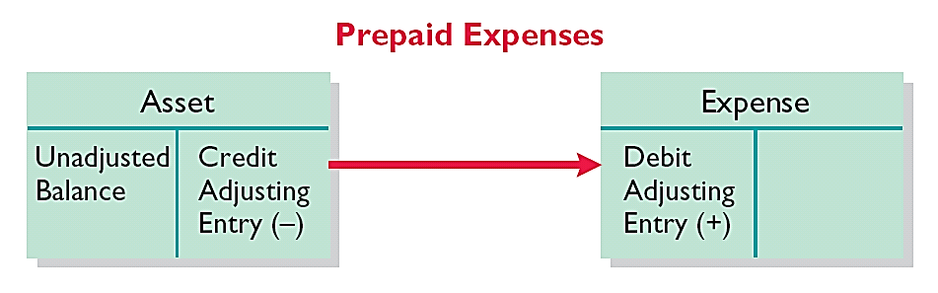
PREPAID EXPENSES
Expire either with the passage of time or through use.
Adjusting entry:
Increase (debit) to an expense account and
Decrease (credit) to an asset account.
Illustration 3-4
Adjusting entries for prepaid
expenses
LO 5

Slide 26
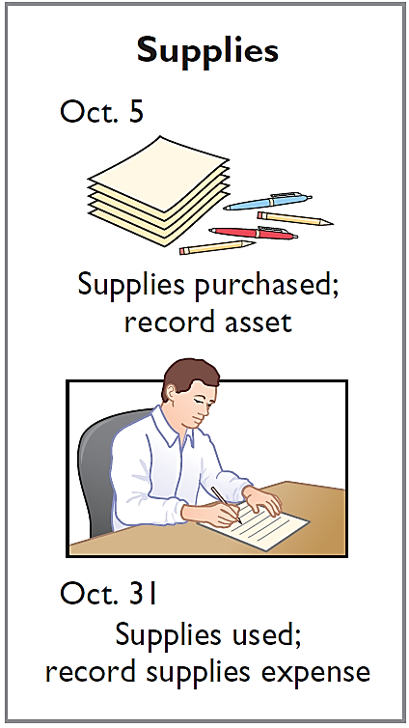
PREPAID EXPENSES
Illustration: Yazici Advertising Inc. purchased supplies costing ₺2,500 on October 5. Yazici recorded the purchase by increasing (debiting) the asset Supplies. This account shows a balance of ₺2,500 in the October 31 trial balance. An inventory count at the close of business on October 31 reveals that ₺1,000 of supplies are still on hand. This means ₺1,500 (₺2,500 - ₺1,000) were used.
Oct. 5
Supplies
2,500
Cash or Accounts Payable
2,500
Adjusting Journal Entry (October 31)
1,500
Oct. 31
Supplies Expense
Supplies
1,500

Slide 27
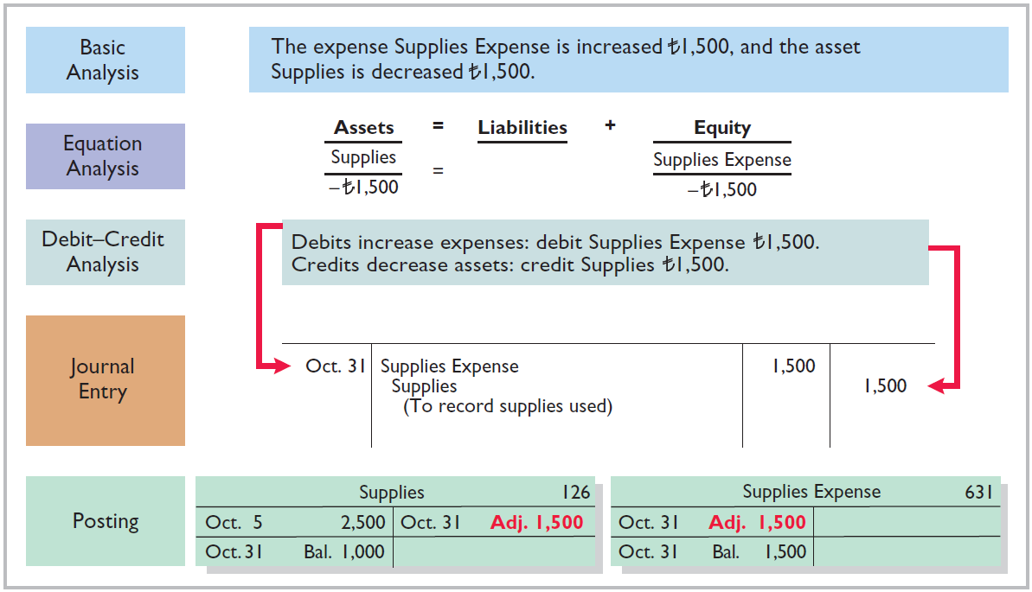
Illustration 3-5
Adjustment for supplies

Slide 28
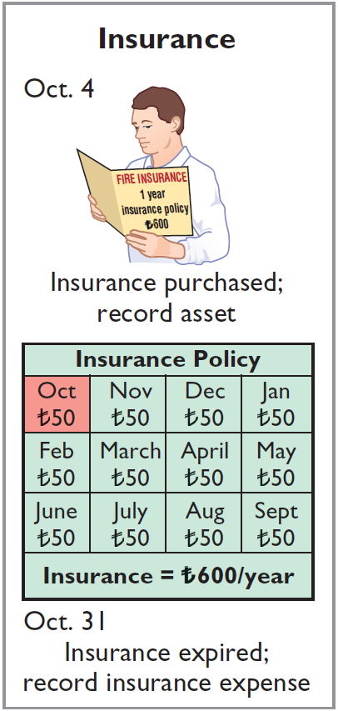
PREPAID EXPENSES
PREPAID EXPENSES
Illustration: On October 4, Yazici Advertising Inc. paid ₺600 for a one-year fire insurance policy. Coverage began on October 1. Yazici recorded the payment by increasing (debiting) Prepaid Insurance. This account shows a balance of ₺600 in the October 31 trial balance. Insurance of ₺50 (₺600 ÷ 12) expires each month. Prepaid Insurance still shows ₺600, meaning no adjustment has been made yet.
Oct. 31
Prepaid Insurance
600
Cash
600
Adjusting Journal Entry (October 31)
Oct. 31
Insurance Expense
50
Prepaid Insurance
50

Slide 29
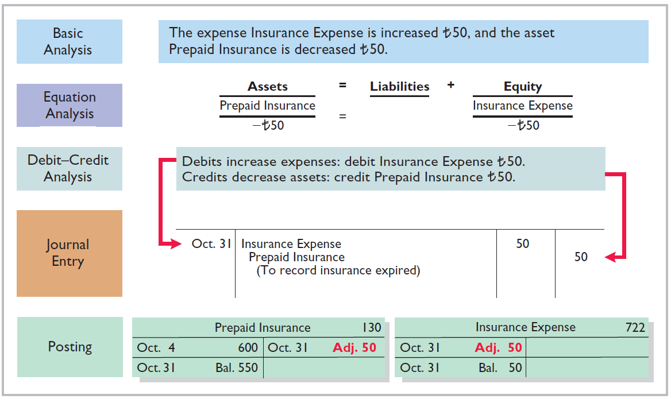
Illustration 3-6
Adjustment for insurance

Slide 30
DEPRECIATION
When you buy something big such as buildings, equipment, and motor vehicles (assets that provide service for many years) you record it as assets, rather than an expense, on the date acquired. You don’t expense it all at once.
Instead, you spread the cost over the years you use it .
Depreciation is a non-cash expense as actual cash does not go out .
Depreciation expense is portrayed in the expense section of statement of net income which results in reduction in the net income .

Slide 31
DEPRECIATION
Depreciation is the process of allocating the cost of an asset to expense over its useful life. Useful life refers to the period of time an asset is expected to be used by a business before it becomes obsolete, inefficient, or no longer economically viable.
Depreciation does not attempt to report the actual change in the value of the asset. It doesn’t reflect how much the asset could be sold for today.

Slide 32
ACCUMULATED DEPRECIATION
Accumulated Depreciation is contra asset account .
It reduces the value of the asset on the statement of financial position.
Accumulated Depreciation tracks total depreciation recorded over the years.
Example: A company buys equipment for $10,000 with a 5-year useful life. It depreciates $2,000 per year.
After 2 years, the book value (accounting value) is $6,000.But the equipment’s actual market value might be $7,000 or $4,000 depending on demand, condition, etc.

Slide 33
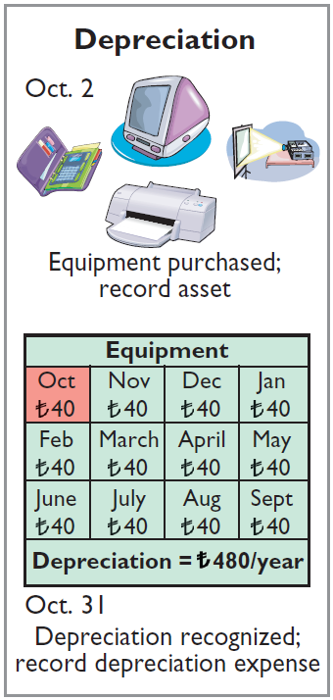
PREPAID EXPENSES
Illustration: For Yazici Advertising, assume that depreciation on the equipment is ₺480 a year, or ₺40 per month.
Oct. 31
40
Depreciation Expense
40
Accumulated Depreciation
Accumulated Depreciation is called a contra asset account.
HELPFUL HINT
All contra accounts have increases, decreases, and normal balances opposite to the account to which they relate.
LO 5

Slide 34
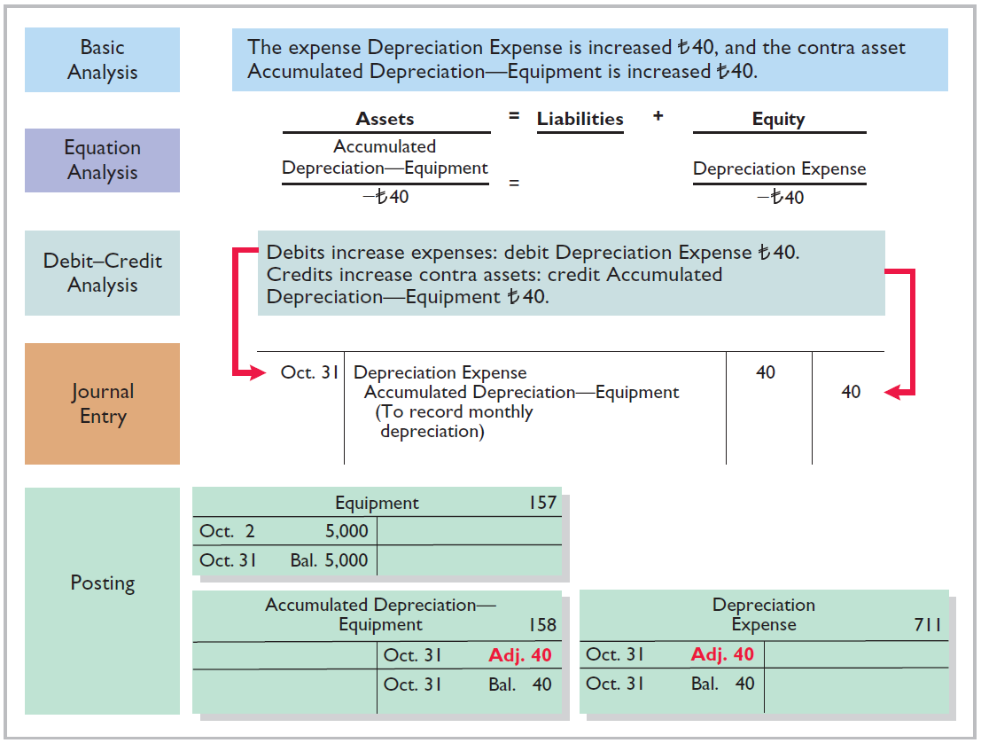
Illustration 3-7
Adjustment for depreciation
LO 5

Slide 35
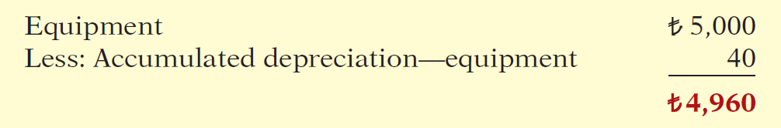
PREPAID EXPENSES
Statement Presentation
Accumulated Depreciation is a contra asset account (credit).
Appears just after the account it offsets (Equipment) on the balance sheet.
Book value is the difference between the cost of any depreciable asset and its accumulated depreciation.
Illustration 3-8
Statement of financial position presentation of accumulated depreciation

Slide 36
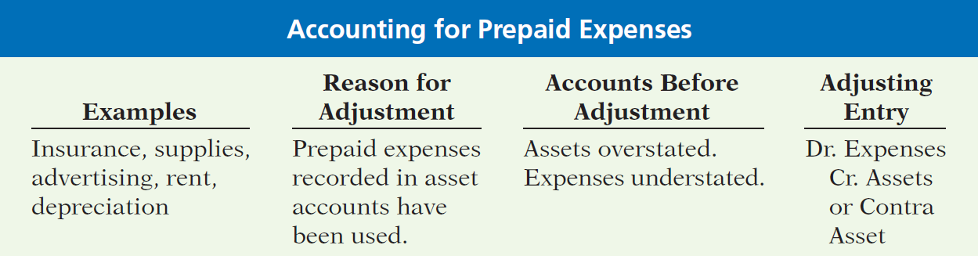
PREPAID EXPENSES
Illustration 3-9
Accounting for prepaid expenses
LO 5

Slide 37
UNEARNED REVENUES
Receipt of cash that is recorded as a liability because the service has not been performed.
Cash Receipt
BEFORE
Revenue Recorded
Unearned revenues often occur in regard to:
Rent
Airline tickets
Magazine subscriptions
Customer deposits
LO 5

Slide 38
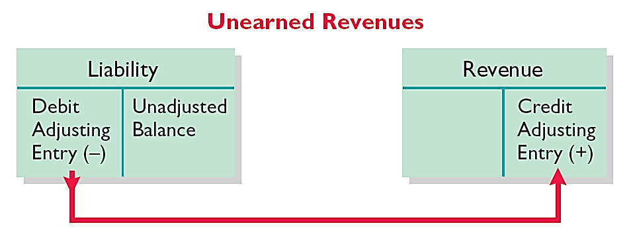
UNEARNED REVENUES
Adjusting entry is made to record the revenue for services performed during the period and to show the liability that remains at the end of the accounting period.
Results in a decrease (debit) to a liability account and an increase (credit) to a revenue account.
Illustration 3-10
Adjusting entries for unearned
revenues
LO 5

Slide 39
UNEARNED REVENUES
Illustration: Yazici Advertising Inc. received ₺1,200 on October 2 from R. Knox for advertising services expected to be completed by December 31. Unearned Service Revenue shows a balance of ₺1,200 in the October 31 trial balance. Analysis reveals that the company performed ₺400 of services in October.
Oct. 31
Unearned Service Revenue
400
Service Revenue
400
LO 5

Slide 40
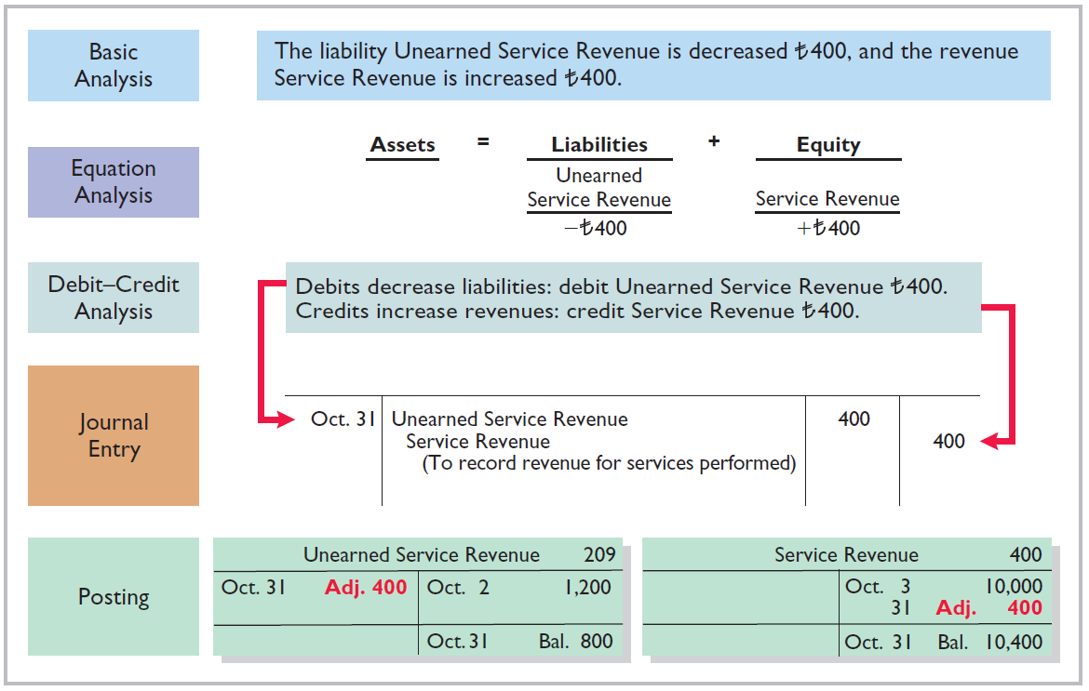
Illustration 3-11
Service revenue accounts after adjustment
LO 5

Slide 41
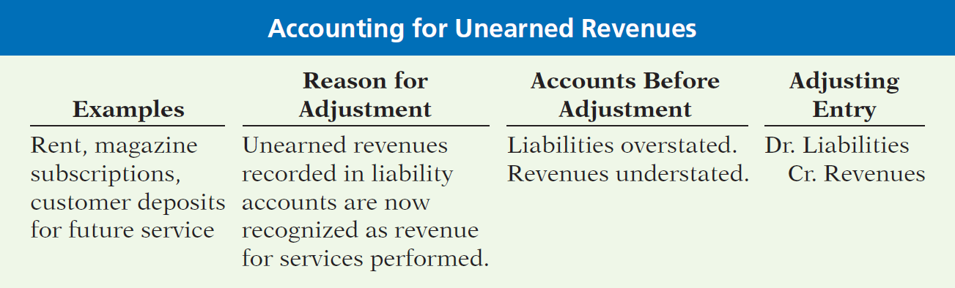
UNEARNED REVENUES
Illustration 3-12
Accounting for unearned revenues
LO 5

Slide 42
>
DO IT!
The ledger of Zhu Company on March 31, 2017, includes these selected accounts before adjusting entries are prepared.
(amounts in thousands) Debit Credit
Prepaid Insurance ¥ 3,600
Supplies 2,800
Equipment 25,000
Accumulated Depreciation—Equipment ¥ 5,000
Unearned Service Revenue 9,200
An analysis of the accounts shows the following.
Insurance expires at the rate of ¥100 per month.
Supplies on hand total ¥800.
The equipment depreciates ¥200 a month.
One-half of the unearned service revenue was performed in March.
Prepare the adjusting entries for the month of March.
LO 5

Slide 43
>
DO IT!
The ledger of Zhu Company on March 31, 2017, includes these selected accounts before adjusting entries are prepared.
(amounts in thousands) Debit Credit
Prepaid Insurance ¥ 3,600
Supplies 2,800
Equipment 25,000
Accumulated Depreciation—Equipment ¥ 5,000
Unearned Service Revenue 9,200
Prepare the adjusting entries for the month of March.
Insurance expires at the rate of ¥100 per month.
Insurance Expense 100
Prepaid Insurance 100
LO 5

Slide 44
>
DO IT!
The ledger of Zhu Company on March 31, 2017, includes these selected accounts before adjusting entries are prepared.
(amounts in thousands) Debit Credit
Prepaid Insurance ¥ 3,600
Supplies 2,800
Equipment 25,000
Accumulated Depreciation—Equipment ¥ 5,000
Unearned Service Revenue 9,200
Prepare the adjusting entries for the month of March.
Supplies on hand total ¥800.
Supplies Expense 2,000
Supplies 2,000
LO 5

Slide 45
>
DO IT!
The ledger of Zhu Company on March 31, 2017, includes these selected accounts before adjusting entries are prepared.
(amounts in thousands) Debit Credit
Prepaid Insurance ¥ 3,600
Supplies 2,800
Equipment 25,000
Accumulated Depreciation—Equipment ¥ 5,000
Unearned Service Revenue 9,200
Prepare the adjusting entries for the month of March.
The equipment depreciates ¥200 a month.
Depreciation Expense 200
Accumulated Depreciation—Equipment 200
LO 5

Slide 46
>
DO IT!
The ledger of Zhu Company on March 31, 2017, includes these selected accounts before adjusting entries are prepared.
(amounts in thousands) Debit Credit
Prepaid Insurance ¥ 3,600
Supplies 2,800
Equipment 25,000
Accumulated Depreciation—Equipment ¥ 5,000
Unearned Service Revenue 9,200
Prepare the adjusting entries for the month of March.
One-half of the unearned service revenue was performed in March.
Unearned Service Revenue 4,600
Service Revenue 4,600
LO 5

Slide 47
Adjusting Entries for Accruals
Learning Objective 6 Prepare adjusting entries for accruals.
Accruals are made to record
Revenues for services performed but not
yet recorded at the statement date
(accrued revenues).
OR
Expenses incurred but not yet paid or recorded at the statement date (accrued expenses).
LO 6

Slide 48
ACCRUED REVENUES
Revenues for services performed but not yet received in cash or recorded.
Revenue Recorded
BEFORE
Cash Receipt
Accrued revenues often occur in regard to:
Rent
Interest
Services performed
LO 6

Slide 49
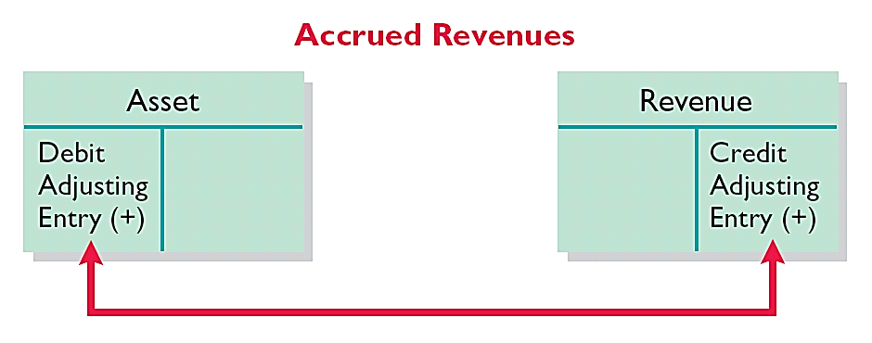
ACCRUED REVENUES
Adjusting entry records the receivable that exists and records the revenues for services performed.
Adjusting entry:
Increases (debits) an asset account and
Increases (credits) a revenue account.
Illustration 3-13
Adjusting entries for accrued
revenues
LO 6

Slide 50
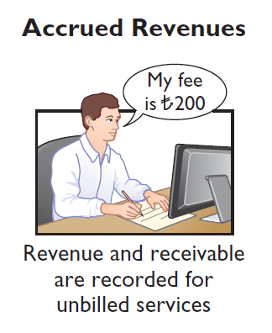
ACCRUED REVENUES
Illustration: In October, Yazici Advertising Inc. performed services worth ₺200 that were not billed to clients in October.
Oct. 31
Accounts Receivable
200
Service Revenue
200
On November 10, Yazici receives cash of ₺200 for the services performed.
Nov. 10
Cash
200
Accounts Receivable
200
LO 6

Slide 51
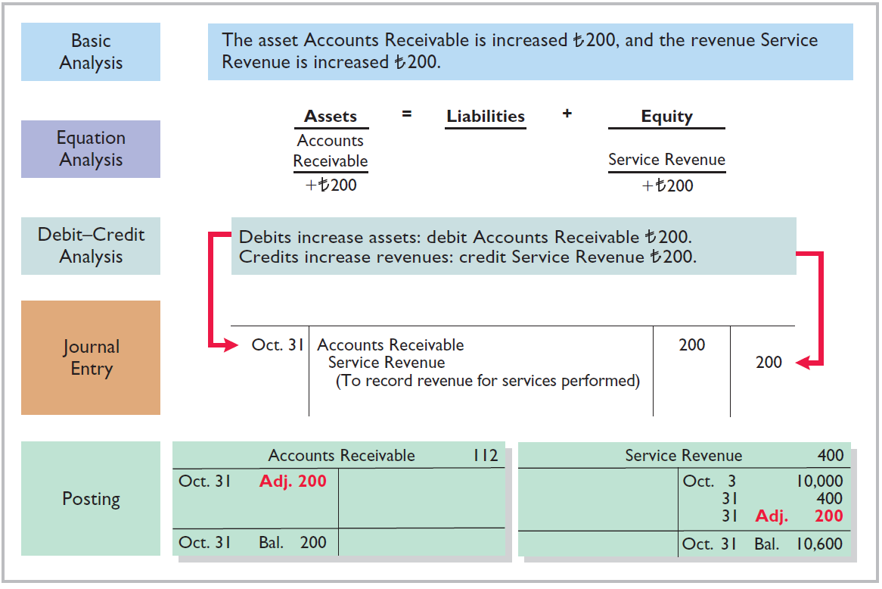
Illustration 3-14
Adjustment for accrued revenue
LO 6

Slide 52
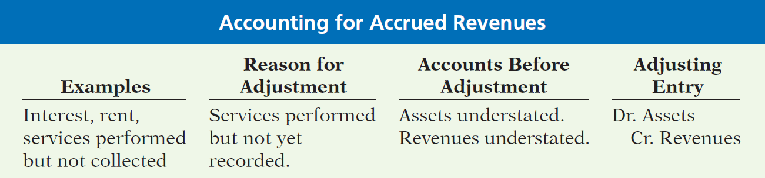
ACCRUED REVENUES
Illustration 3-15
Accounting for accrued revenues
LO 6

Slide 53
ACCRUED EXPENSES
Expenses incurred but not yet paid in cash or recorded.
Expense Recorded
BEFORE
Cash Payment
Accrued expenses often occur in regard to:
Interest
Taxes
Salaries
LO 6

Slide 54
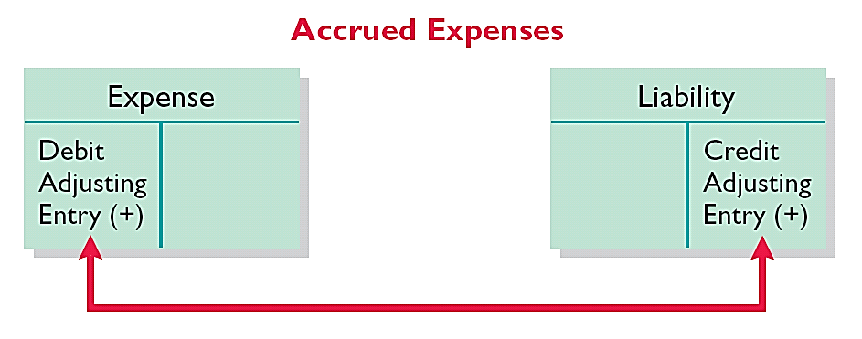
ACCRUED EXPENSES
Adjusting entry records the obligation and recognizes the expense.
Adjusting entry:
Increase (debit) an expense account and
Increase (credit) a liability account.
Illustration 3-16
Adjusting entries for accrued expenses
LO 6

Slide 55
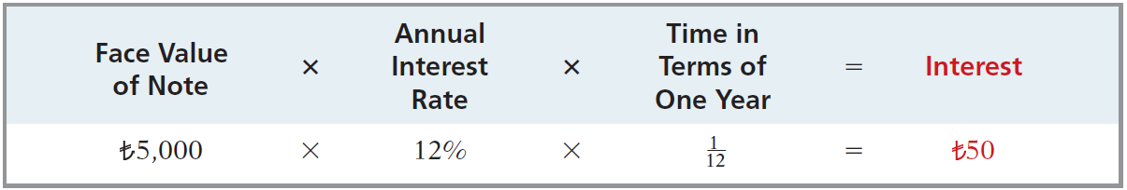
ACCRUED INTEREST
Illustration: Yazici Advertising Inc. signed a three-month note payable in the amount of ₺5,000 on October 1. The note requires Yazici to pay interest at an annual rate of 12%.
Illustration 3-17
Formula for computing interest
Oct. 31
Interest Expense
50
Interest Payable
50
LO 6

Slide 56
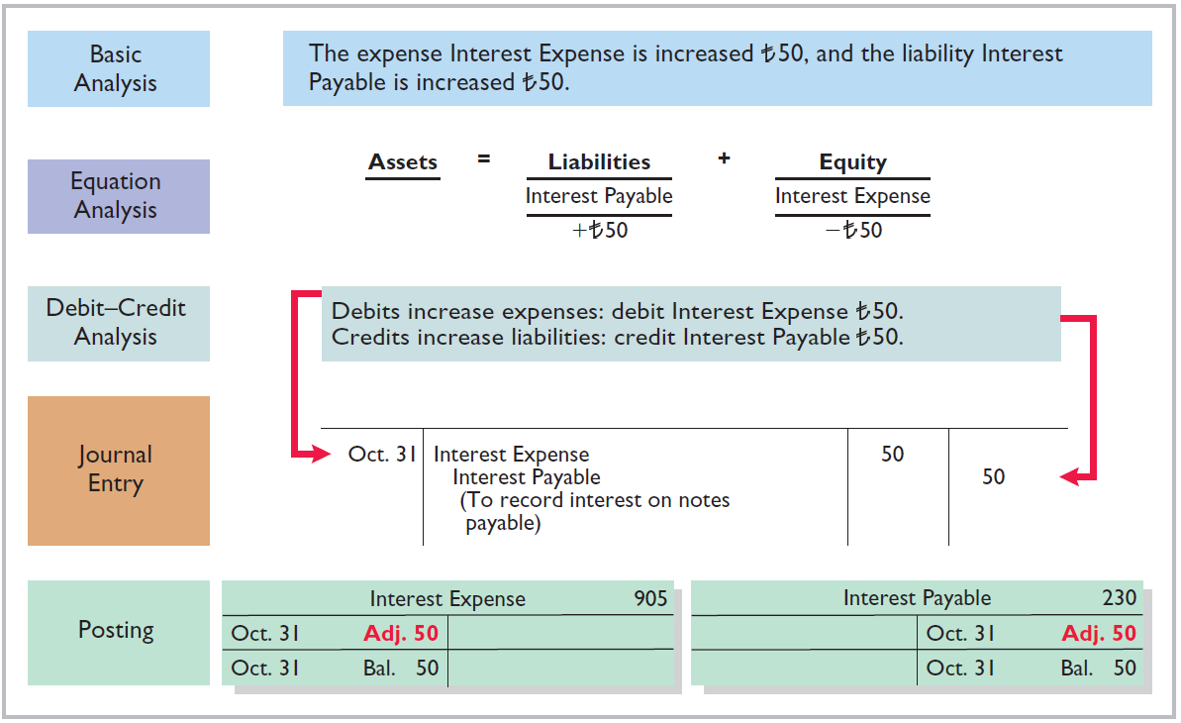
Illustration 3-18
Adjustment for accrued interest
LO 6

Slide 57
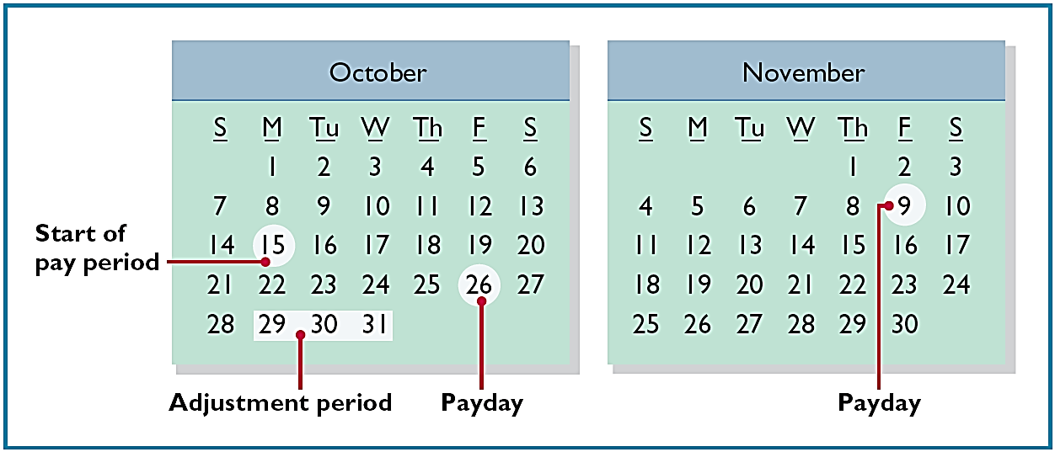
ACCRUED SALARIES AND WAGES
Illustration: Yazici paid salaries and wages on October 26; the next payment of salaries will not occur until November 9. The employees receive total salaries of ₺2,000 for a five-day work week, or ₺400 per day. Thus, accrued salaries at October 31 are ₺1,200 (₺400 x 3 days).
Illustration 3-19
Calendar showing Yazici’s pay
periods
LO 6

Slide 58
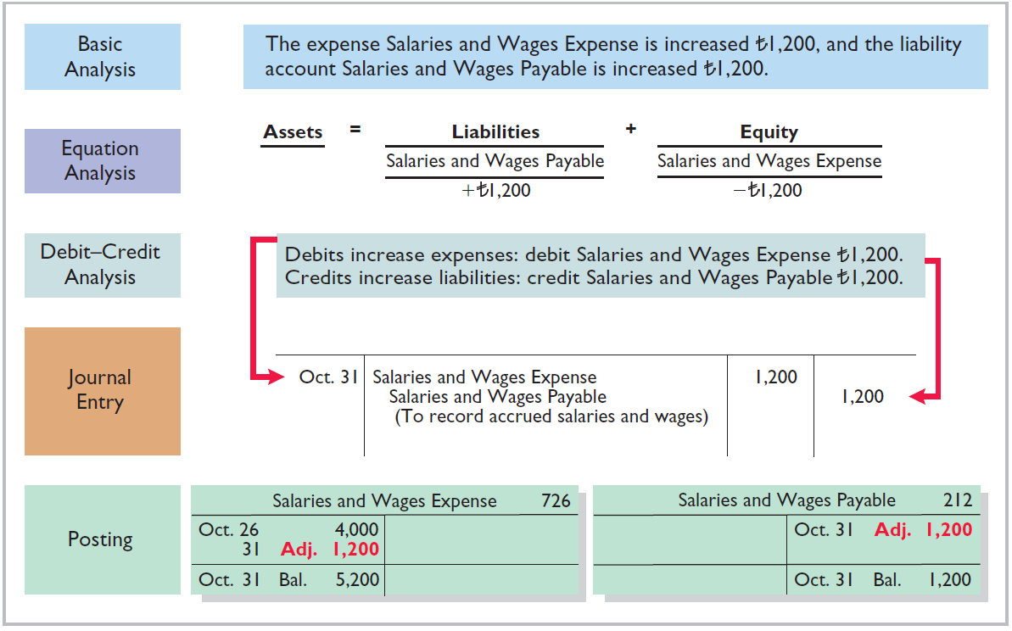
Illustration 3-20
Adjustment for accrued salaries and wages
LO 6

Slide 59
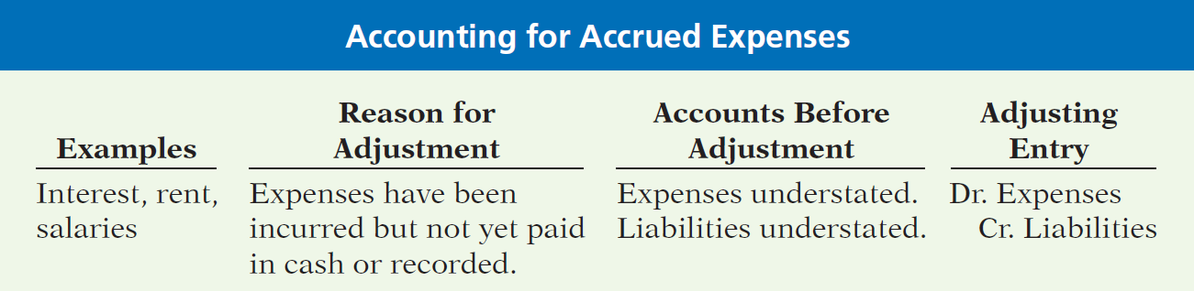
ACCRUED EXPENSES
Illustration 3-21
Accounting for accrued expenses
LO 6

Slide 60
>
DO IT!
Micro Computer Services began operations on August 1, 2017. At the end of August 2017, management prepares monthly financial statements. The following information relates to August.
At August 31, the company owed its employees ¥8,000 in salaries and wages that will be paid on September 1.
On August 1, the company borrowed ¥300,000 from a local bank on a 15-year mortgage. The annual interest rate is 10%.
Revenue for services performed but unrecorded for August totaled ¥11,000.
Prepare the adjusting entries needed at August 31, 2017.
LO 6

Slide 61
>
DO IT!
Prepare the adjusting entries needed at August 31, 2017.
At August 31, the company owed its employees ¥8,000 in salaries and wages that will be paid on September 1.
On August 1, the company borrowed ¥300,000 from a local bank on a 15-year mortgage. The annual interest rate is 10%.
Revenue for services performed but unrecorded for August totaled ¥11,000.
Salaries and Wages Expense 8,000
Salaries and Wages Payable 8,000
Interest Expense 2,500
Interest Payable 2,500
Accounts Receivable 11,000
Service Revenue 11,000
LO 6

Slide 62
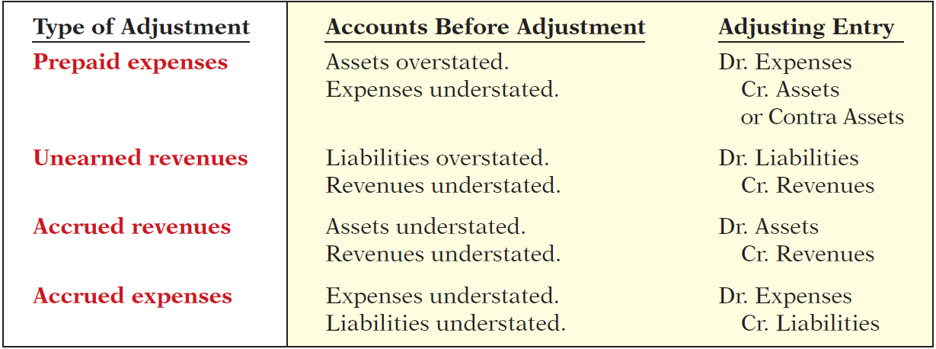
Summary of Basic Relationships
Illustration 3-22
Summary of adjusting entries
LO 6

Slide 63
The Adjusted Trial Balance and Financial Statements
Learning Objective 7
Describe the nature and purpose of an
adjusted trial balance.
Preparing the Adjusted Trial Balance
Prepared after all adjusting entries are
journalized and posted.
Purpose is to prove the equality of debit balances and credit balances in the ledger.
Is the primary basis for the preparation of financial statements.
LO 7

Slide 64
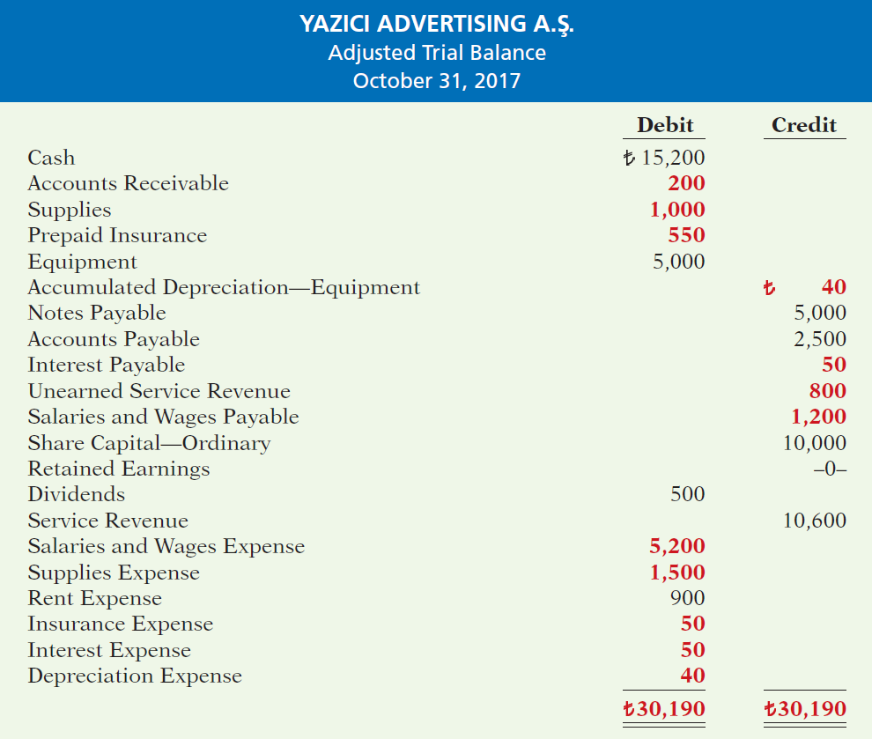
Illustration 3-25
Adjusted trial balance
LO 7

Slide 65
Preparing the Adjusted Trail Balance
Question
Which of the following statements is incorrect concerning the adjusted trial balance?
(a) An adjusted trial balance proves the equality of the total debit balances and the total credit balances in the ledger after all adjustments are made.
The adjusted trial balance provides the primary basis for the preparation of financial statements.
The adjusted trial balance lists the account balances segregated by assets and liabilities.
The adjusted trial balance is prepared after the adjusting entries have been journalized and posted.
LO 7

Slide 66
Preparing Financial Statements
Financial Statements are prepared directly from the Adjusted Trial Balance.
Income Statement
Retained Earnings Statement
Statement of Financial Position
LO 7

Slide 67
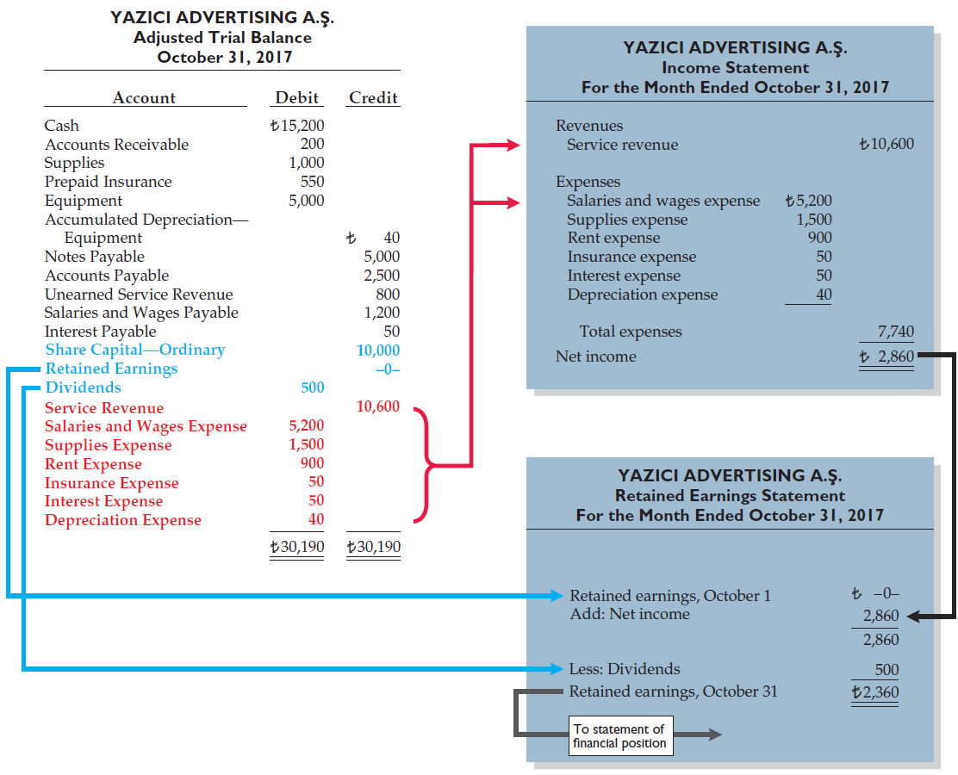
Illustration 3-26
Preparation of the income statement and retained earnings statement from the adjusted trial balance
LO 7

Slide 68
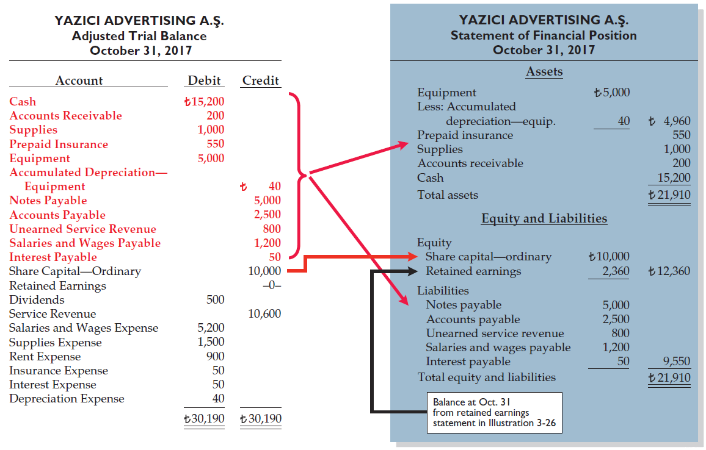
Illustration 3-27
Preparation of the statement of financial position from the adjusted trial balance
LO 7

Slide 69
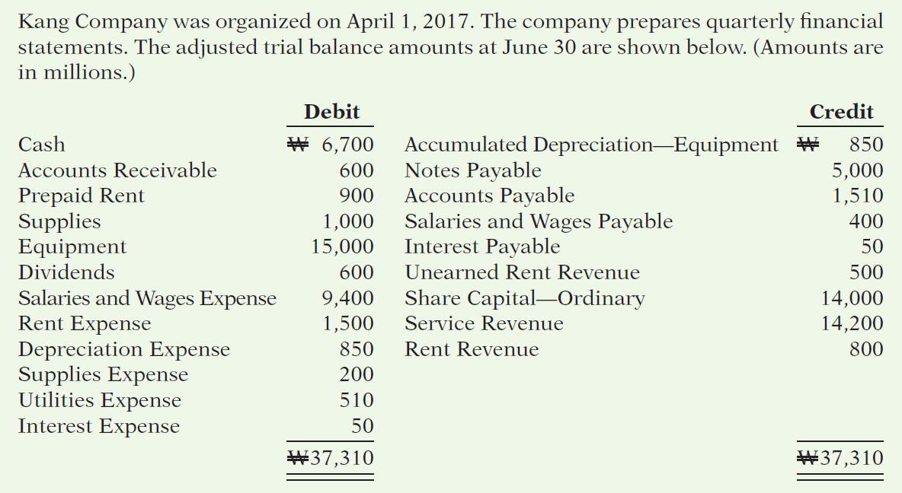
>
DO IT!
LO 7

Slide 70
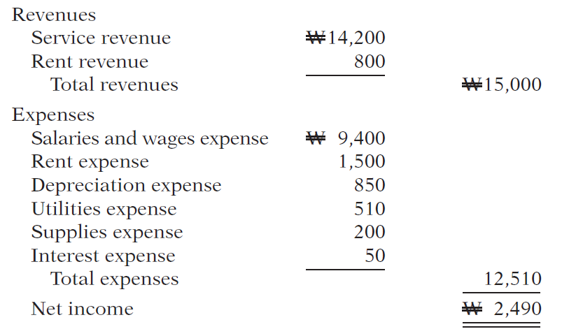
>
DO IT!
(a) Determine the net income for the quarter April 1 to June 30.
LO 7

Slide 71
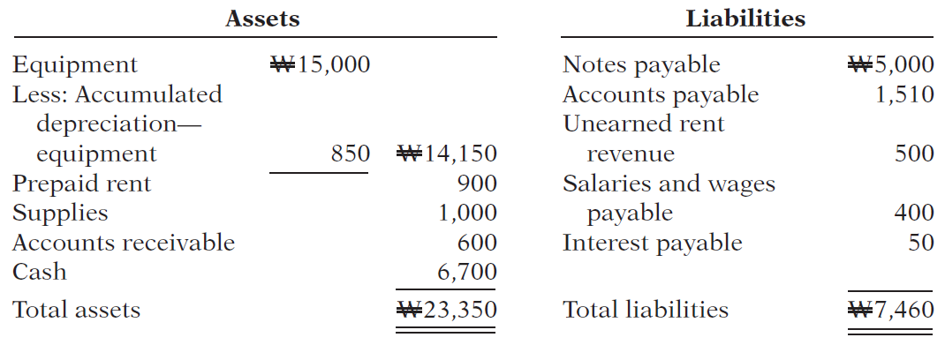
>
DO IT!
Determine the total assets and total liabilities at June 30, 2017, for Skolnick Co.
LO 7

Slide 72
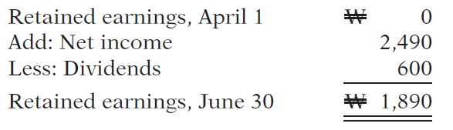
>
DO IT!
Determine the amount that appears for retained earnings at June 30, 2017.
LO 7

Slide 73
APPENDIX 3A
Alternative Treatment of Prepaid Expenses and Unearned Revenues
Learning Objective 8
Prepare adjusting entries for the alternative
treatment of deferrals.
Alternate Treatment
When a company prepays an expense, it debits that amount to an expense account.
When it receives payment for future services, it credits the amount to a revenue account.
LO 8

Slide 74
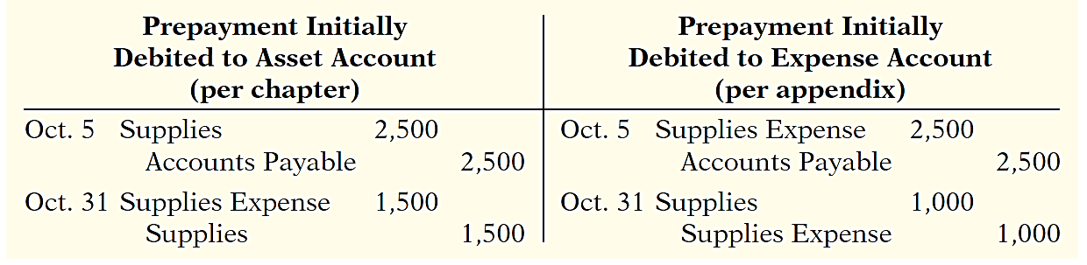
Prepaid Expenses
Company may choose to debit (increase) an expense account rather than an asset account. This alternative treatment is simply more convenient.
Illustration 3A-2
Adjustment approaches—a comparison
LO 8

Slide 75
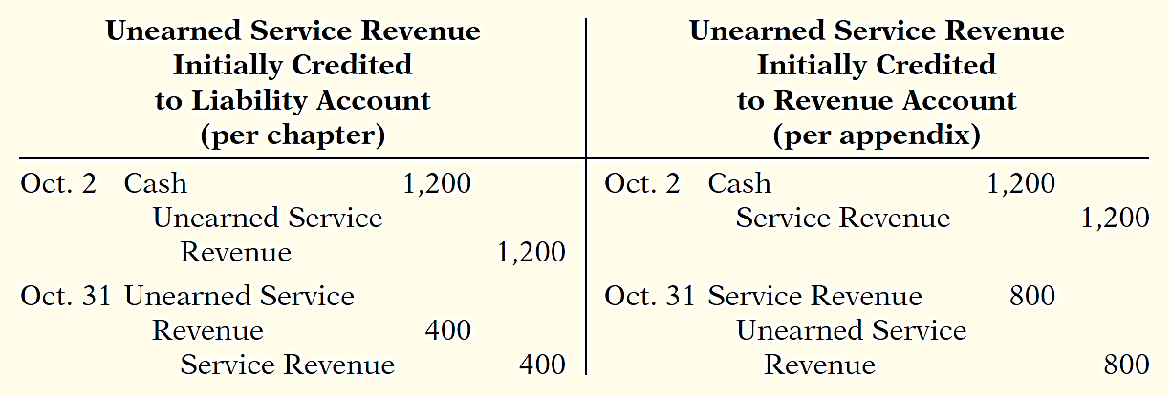
Unearned Revenues
Company may credit (increase) a revenue account when they receive cash for future services.
Illustration 3A-5
Adjustment approaches—a comparison
LO 8

Slide 76
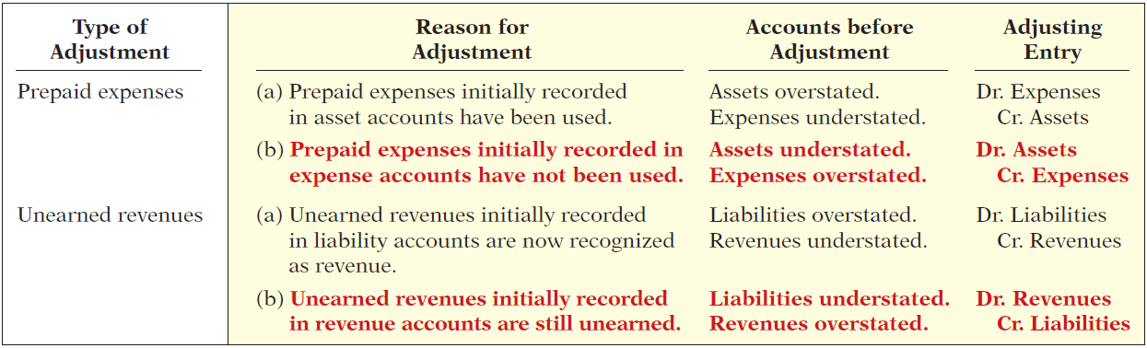
Summary of Additional Adjustments Relationships
Illustration 3A-7
Summary of basic relationships for deferrals
LO 8

Slide 77
APPENDIX 3B
Concepts in Action
Learning Objective 9
Discuss financial reporting concepts.
Qualities of Useful Information
Two fundamental qualities, relevance and
faithful representation.
Relevance
Make a difference in a business decision.
Provides information that has predictive value and confirmatory value.
Materiality is a company-specific aspect of relevance.
An item is material when its size makes it likely to influence the decision of an investor or creditor.
LO 9

Slide 78
Qualities of Useful Information
Two fundamental qualities, relevance and faithful representation.
Faithful Representation
Information accurately depicts what really happened.
Information must be
complete (nothing important has been omitted),
neutral (is not biased toward one position or another), and
free from error.
LO 9

Slide 79
Qualities of Useful Information
ENHANCING QUALITIES
Comparability results when different companies use the same accounting principles.
Information is verifiable if independent
observers, using the same methods, obtain similar results.
Information has the quality of understandability
if it is presented in a clear and concise fashion.
Consistency means that a company uses the same accounting
principles and methods from year to year.
For accounting information to have relevance, it must be timely.
LO 9

Slide 80
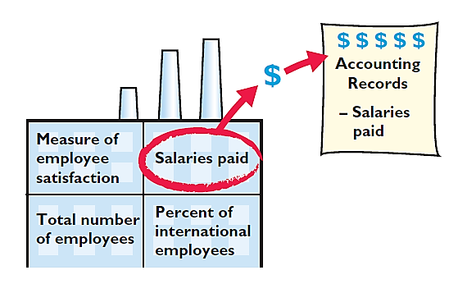
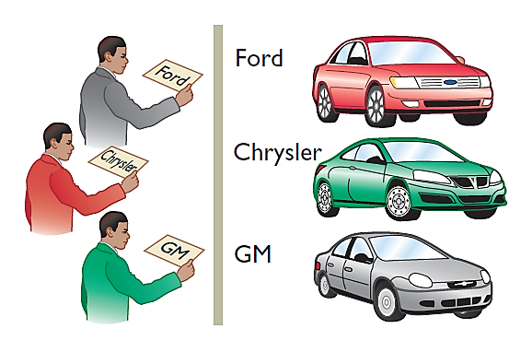
Assumptions in Financial Reporting
Monetary Unit
Economic Entity
Requires that only those things that can be expressed in money are included in the accounting records.
States that every economic entity can be separately identified and accounted for.
Illustration 3B-2
Key assumptions in financial reporting
LO 9

Slide 81
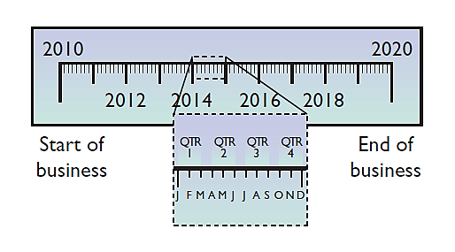

Assumptions in Financial Reporting
Time Period
Going Concern
States that the life of a business can be divided into artificial time periods.
The business will remain in operation for the foreseeable future.
Illustration 3B-2
Key assumptions in financial reporting
LO 9

Slide 82
Principles of Financial Reporting
MEASUREMENT PRINCIPLES
Historical Cost
Fair Value
Or cost principle, dictates that companies record assets at their cost.
Indicates that assets and liabilities should be reported at fair value (the price received to sell an asset or settle
a liability).
LO 9

Slide 83
Principles of Financial Reporting
REVENUE RECOGNITION PRINCIPLE
EXPENSE RECOGNITION PRINCIPLE
FULL DISCLOSURE PRINCIPLE
Requires that companies recognize revenue in the accounting period in which the performance obligation is satisfied.
Dictates that efforts (expenses) be matched with results (revenues). Thus, expenses follow revenues.
Requires that companies disclose all circumstances
and events that would make a difference to financial statement users.

Slide 84
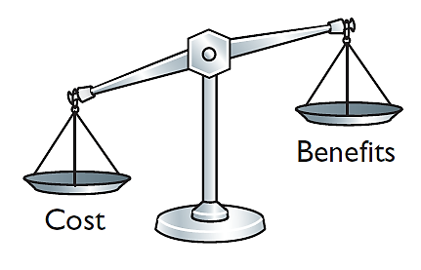
Cost Constraint
Cost Constraint
Accounting standard-setters weigh the cost that companies will incur to provide the information against the benefit that financial statement users will gain from having the information available.
LO 9

Slide 85
Assignment
E3-4, E3-6,E3-7,E3-9,E3-10
E3-13
LO 9

Slide 86





















THANK YOU
Use these design resources in your Canva Presentation.
Happy designing!
Don't forget to delete this page before presenting.

